Slide 1

Spring Framework Spring MVC Architecture
Presented By
Ch.Satti Babu

Slide 2
Agenda
Introduction to Spring Framework
Evolution of Spring
Advantages of Spring
Spring Architecture
Spring Versions
Spring Core Module
IOC Container
Dependency Injection
Constructor based Injection
Setter Injection
Field Injection

Slide 3
Continued…
Spring MVC Architecture
Front Controller Design Pattern
Dispatcher Servlet
Handler Mapper
Controller
ModelAndView Object
View Resolver
View

Slide 4
What is Spring Framework?
A framework is a platform for developing software Applications. It provides a foundation on which Developers will build an Application. Framework is a semi developed common logics
Spring Technology involves into Several modules: Spring is a framework to build an end to end application. It reduces the boiler plate coding.
Two types of Frameworks are available in java
1. Web Framework -- Struts
2. ORM Framework - Hibernate
Spring is an application development framework.
An application consists of multiple layers.
1. Application Layer
2. Web Layer
3. Service Layer
4. Persistence Layer
5. Database

Slide 5
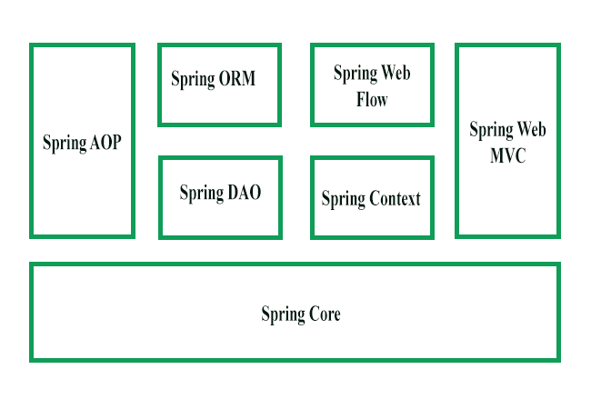
Continued…
Spring is not a single Framework it is a collection of Frameworks. Spring Framework is developed in modular fashion.
Spring Core
Spring Context
Spring AOP
Spring DAO
Spring Web MVC
Spring ORM

Slide 6
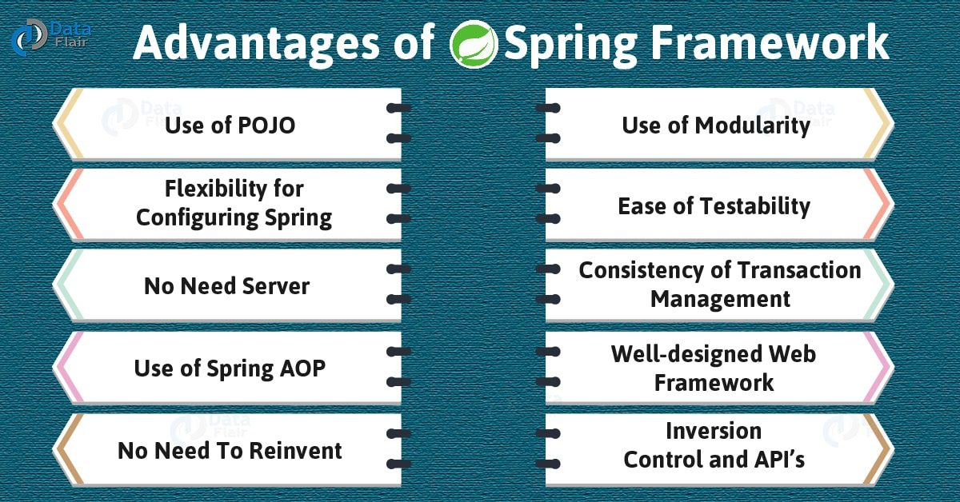

Slide 7
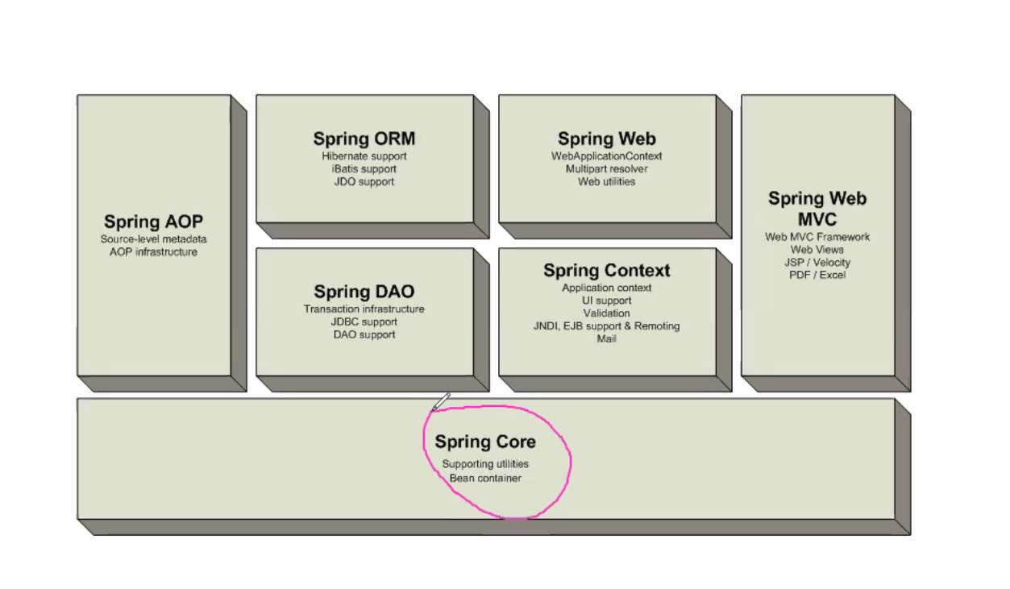
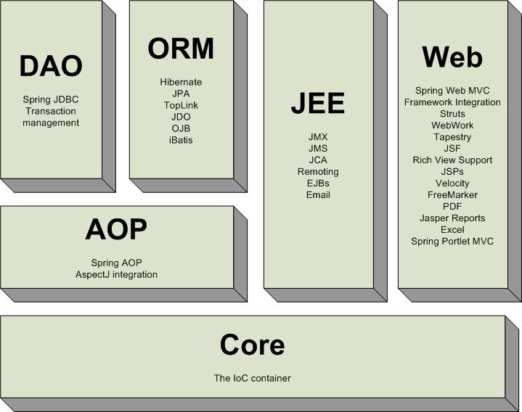
Spring Versions
Spring 1.x
Spring 2.x

Slide 8
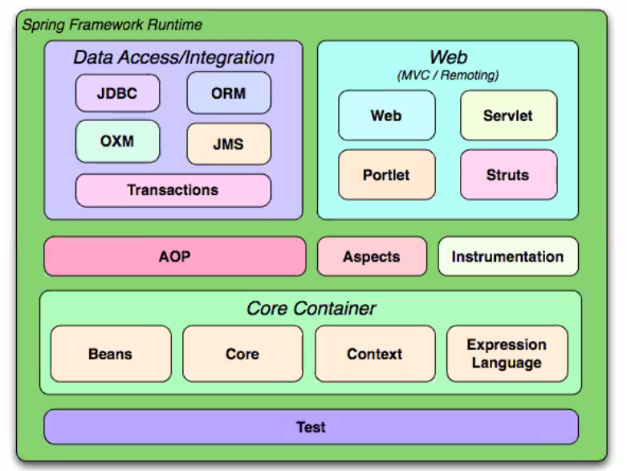
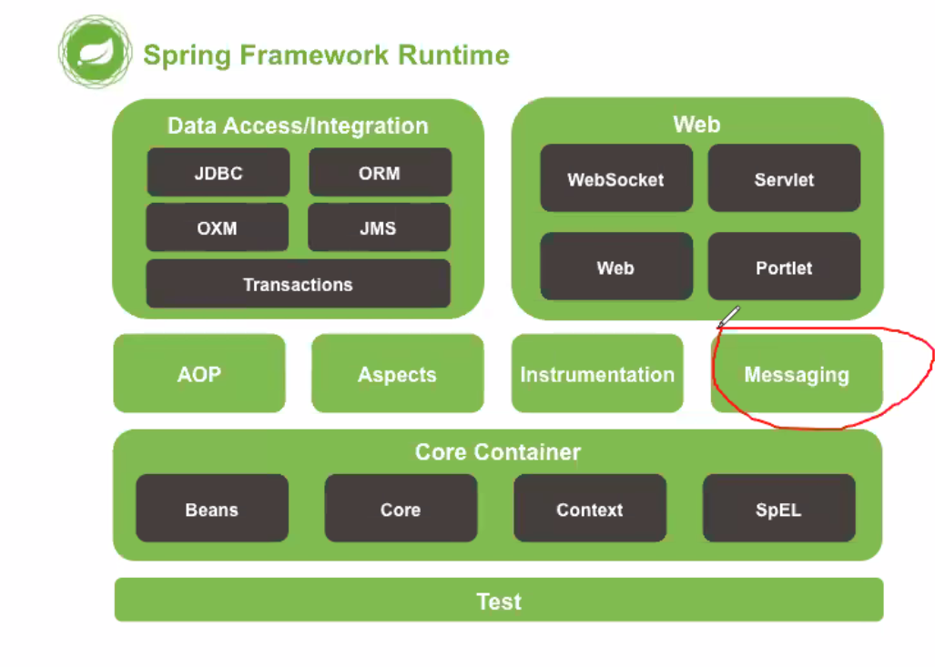
Continued…
Spring 3.x
Spring 4.x

Slide 9
Spring Modules
Spring Core Module:- It is a base module for spring framework. This module providing fundamental concepts of Spring. They are IOC and DI.
IOC:- Inversion of Control
DI:- Dependency Injection.
Spring Context Module:- It will take care of Configurations required in our application.
Spring AOP(Aspect Oriencted Programming) :- It separates Business logic and secondary logic in application.

Slide 10
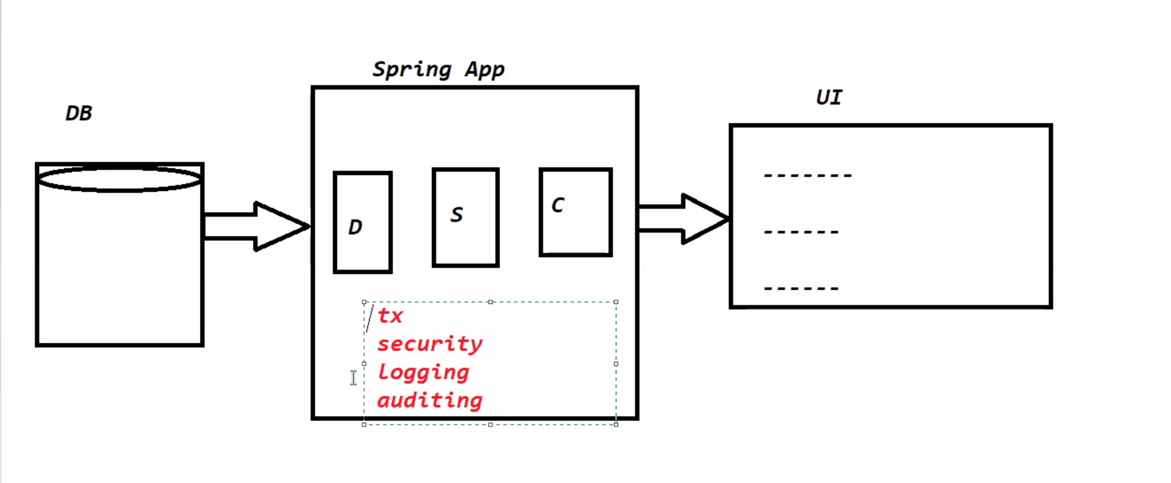
Continued…
Spring AOP

Slide 11
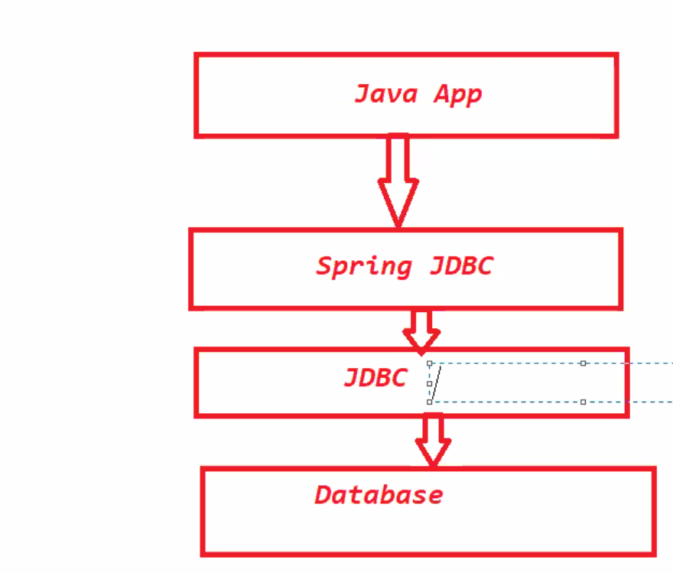
Spring DAO(Spring JDBC)

Slide 12
Continued…
Spring Web MVC:- Spring Web MVC is used to develop the Web Applications and distributed applications . It is developed on top of Servlets.
Web Applications:- Gmail,
Distributed Applications:- Webservices.
Spring ORM Module:- It is used to develop the Persistence Layer
ORM:- Object Relational Mapping
It is used to represent the data in the form of object

Slide 13
Dependency Injection
The process of injecting Dependent object into Target object is called Dependency Injection
Types of Dependency Injection
Setter based Injection:-The process of injecting Dependent object into Target object by using Target class Setter method is called Setter Injection.
<bean id="tyre" class="com.sattibabu.vehiclesystem.Tyre">
<property name="brand" value="MRF"></property>
</bean>
Constructor based injection:- The process of injecting Dependent object into Target object by using Target class Constructor is called Constructor based injection.
<bean id="vehicle" class="com.sattibabu.vehiclesystem.Vehicle">
<constructor-arg name="brand" value="MRF“/>
</bean>
Field based Injection:- The process of injecting Dependent object into Target object by using members of the Target class is called Field based Injection.

Slide 14
Continued…
We can do the Dependency injection by using Annotations as well. That is called Annotation based Dependency Injection
Annotations which are used for DI
@Component:- It allows to detect spring to automatically detect the custom beans
@Primary:- This annotation is useful when we want to specify which bean of a certain type should be injected by default.
@Qualifier:- If both the @Qualifier and @Primary annotations are present, then the @Qualifier annotation will have precedence. Basically, @Primary defines a default, while @Qualifier is very specific.

Slide 15
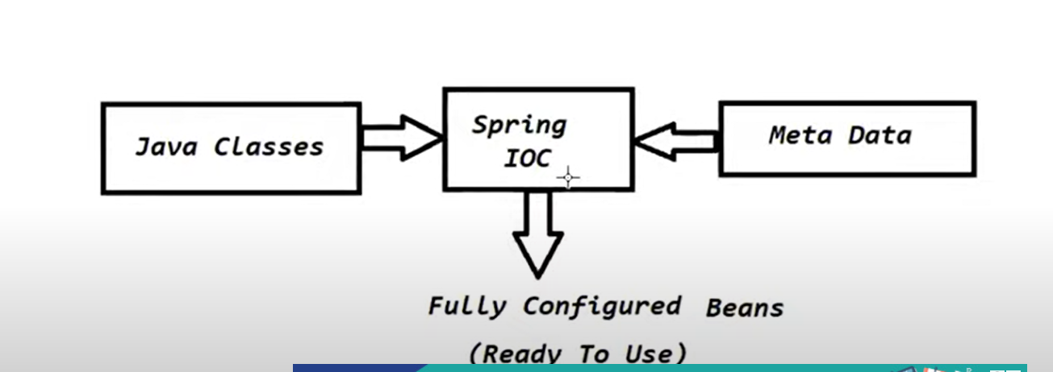
IOC(Inversion of Control) Container
IOC container is a principle which is used to manage and collaborate the dependencies among the objects in an Application.

Slide 16
Steps to Develop a spring Application
Create a maven project using quick-start-archetype
Add spring-context dependency in pom.xml (Project Object Model)
Create classes which are required by using Strategy Design pattern
Create Configuration file and Configure Bean definitions which will be used by IOC to perform DI
Start the IOC container and get the bean obj and test the application.

Slide 17
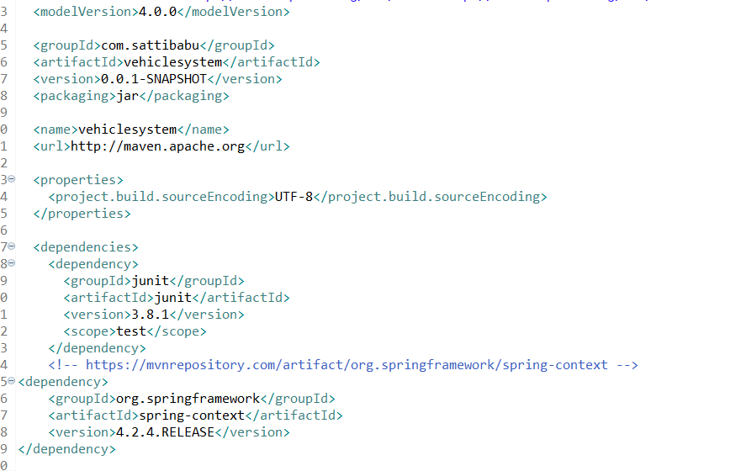
Adding the Dependencies in pom.xml

Slide 18
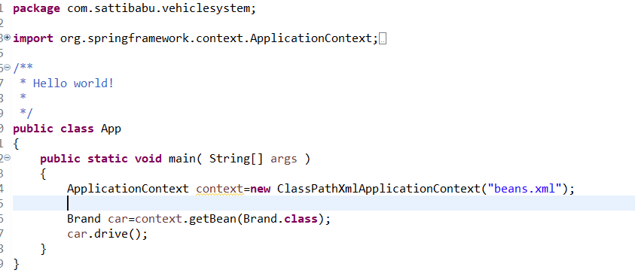
Creating a configuration file

Slide 19
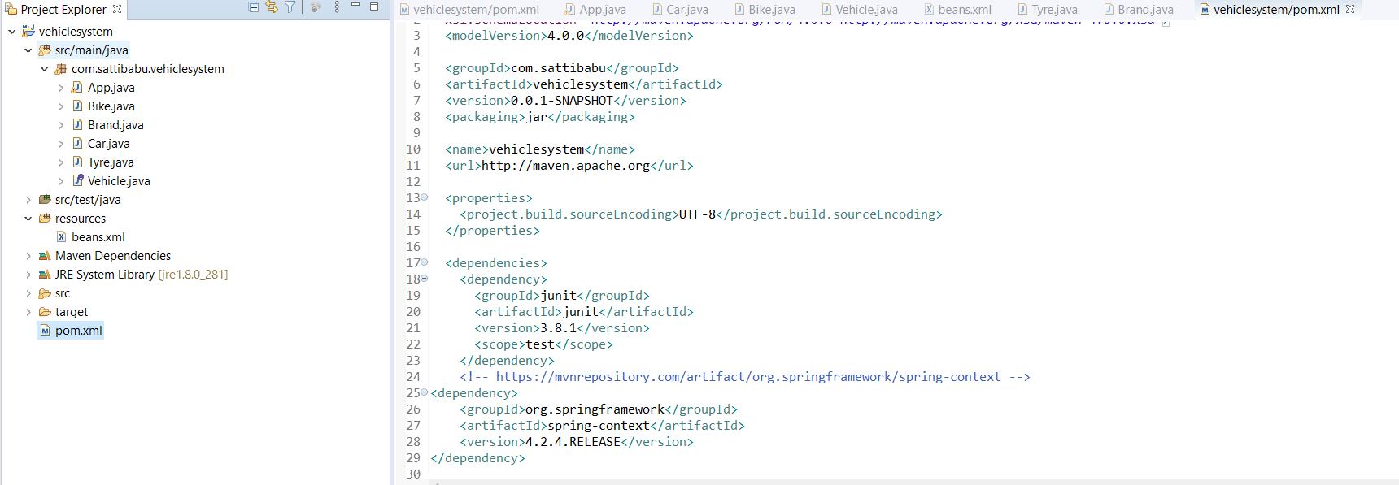
Spring Application folder Structure

Slide 20
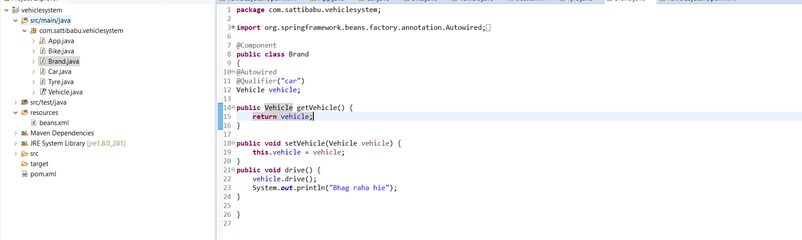
Dependency Injection

Slide 21
Spring MVC Architecture
Spring MVC module is a type of Spring Framework which is used to providing Form binding support.
Supporting for IITN applications also.
Spring MVC Components
Spring MVC Architecture
Request Execution flow in Spring MVC application.
Spring MVC Components :- Spring MVC is designed based on two design patterns Spring MVC and Front Controller Design pattern.
Front Controller (Dispatcher Servlet)
Controller
ModelandView
View Resolver
View
Request ------------→ Preprocessing --------→Server-----→ Post Processing ---------→Request

Slide 22
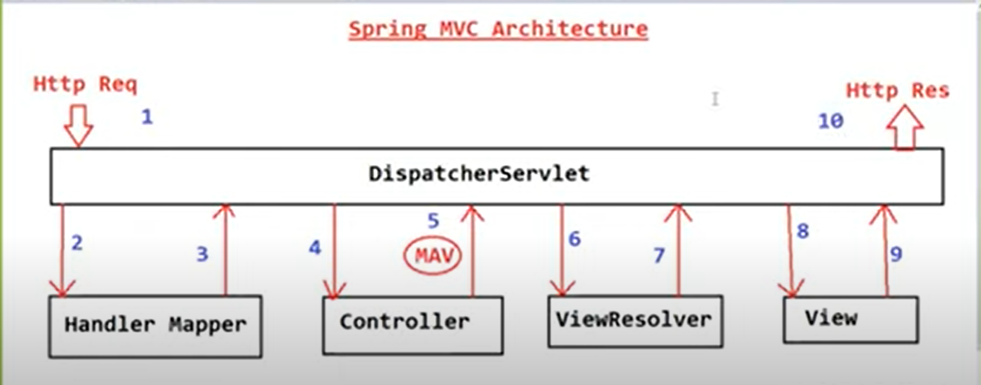
Continued…
Dispatcher Servlet
Handler Mapper
Controller
ModelAndView
View Resolver
View

Slide 23
Continued…
Controller:- Controller is a program which is responsible to handle request.
ModelAndView Object:- Once Request processing is completed controller will return ModelAndView Object to DispatcherServlet. ModleAndView is a predefined class in Spring MVC Framework.
View Resolver:- Controller returns the ModelAndView Object. DispatcherServlet should identify the location of view file. But DispatcherServlet will not identify the location of view file.
View Component:- It is responsible to render the data on view file.
Request Execution flow in Spring MVC Appliacation:-
Incoming HTTP Request will be received by Dispatcher Servlet. DS is the pre defined servlet in Spring MVC and it is acting as front controller to perform pre processing and post processing.
DispatcherServlet will send the request to the Request Handler.
HandlerMapper will identify which is responsible to handle this request and send details of Handler details to DispatcherServlet.

Slide 24


